Slide 1


Dollar Sign Prediction for New Businesses on Yelp
Team 11: Poonam Shrichand Ahuja
Vincentia Angelica
Cloris He
Martin Gui

Slide 2
Agenda
Executive Summary (Background, Goals, Steps)
Data Modelling
Key TakeAways
Data Findings and What can be done better?
Data Pre-processing
Notes:
coming to agenda, these are the major components of this entire project.
We will go through all of these specifically very shortly.

Slide 3
Executive Summary – (1/2) Main goal to predict $ based on housing prices & restaurant features
Background
Predict dollar sign based on the relationship between Housing ($) and Restaurant($)
Goal
Methodology
Using algorithms to predict $ based on housing price & restaurant features
To help Yelp to improve the app by predicting dollar sign for new businesses
Since there is no relationship --> Predict dollar sign with the housing price range and other attributes
Notes:
On the executive smarmy, The business background of this project is to predict the dollar sign for new restaurant on the yelp app. Because, yelp assign the number of dollar assign based on customers ' review. New restaurant go into this business without lots of reviews. For example, If a yelp user filters restaurant based on the dollar sign, these new restaurant will not be showing up. Therefore, we are using our machine learning model to help predict dollar assign for new restaurant on yelp.
Initially, our first reaction was to see if there is relationship between housing dollar sign and restaurant dollar sign based on the theory rich Neiborhood might come with expensive restaurant. However, Since there is no relationship between the two after exploring the data. We decided to predict dollar sign with the housing price range and restaurant attributes

Slide 4

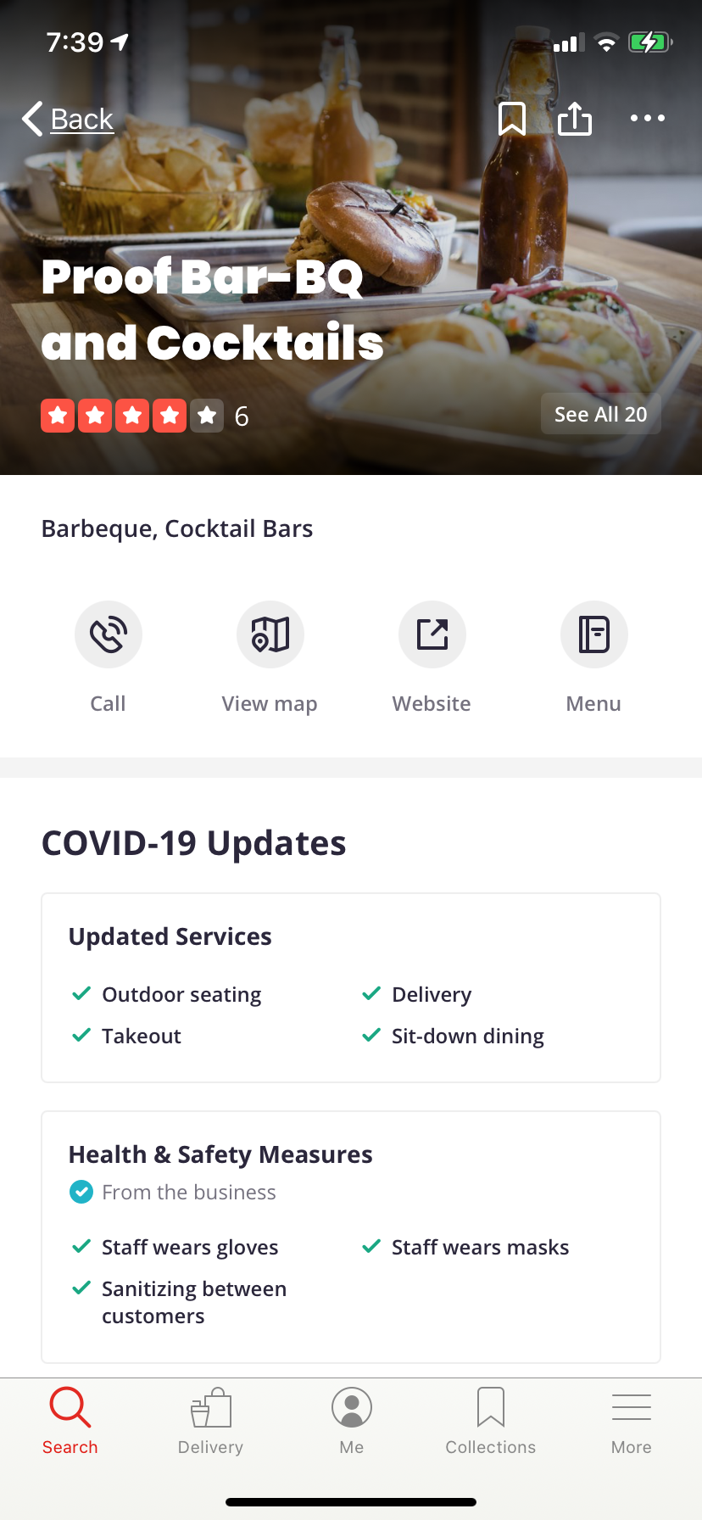
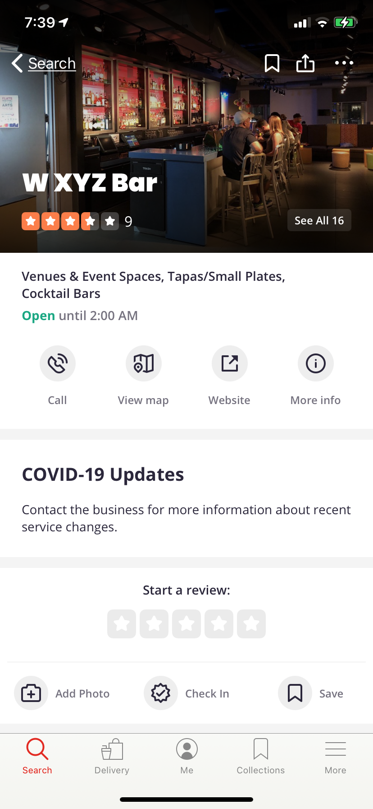
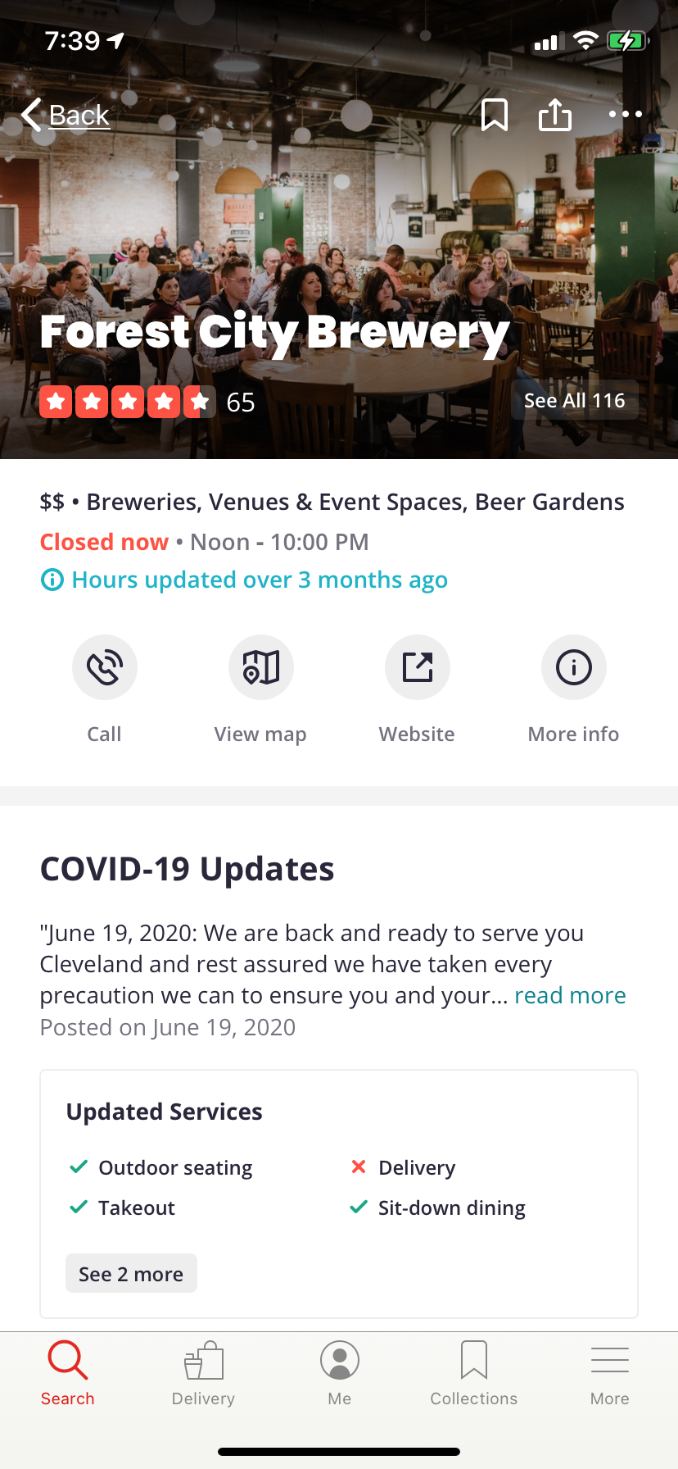
Why Build the Model?
Notes:
The coming up example will better asist you to comprehend the business background visually.

Slide 5
Steps
Dataset
Yelp and Zillow
Pull the data from Yelp and Zillow API
Data Cleaning
Yelp: Open attribute and category columns to get more features
Zillow: calculated quantiles by states in US to normalize the housing price
Modeling
Naïve Bayes & Random Forest
Notes:
This is the overall major components of this project.
We pulled the data, merged the two data, cleaned the data and built our machine learning model the best possible accuracy.

Slide 6
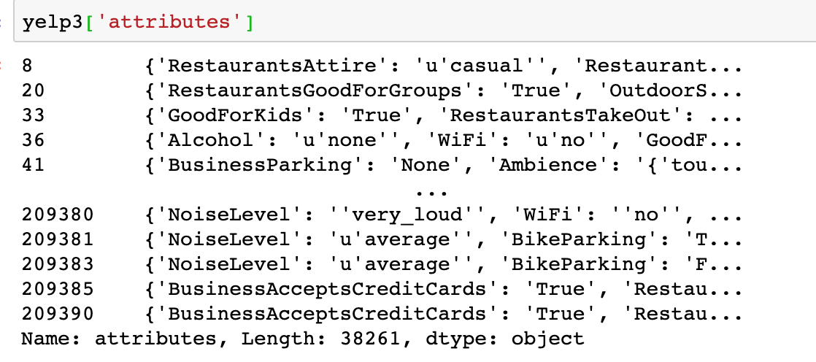
Data Preprocessing - Yelp
Filtered only restaurants in the US
Opened the 'attributes' &'category' columns to obtain more features
Converted into dummies Variables
Notes:
The most rewarding part of cleaning the yelp dataset is to extract out all important information.
We first is extracted only the restaurants in the united states
The coloum "attributes" comes with dictionary format elements. Since these keys represents overall features of those restaurants on yelp. We needed to unzipped the dictionary data and extracted out the keys. Things like " noise level", "alcohol service", "business parking" and "good for kids". Then put them as columns .
because our dataset has lots of other categorical data we also converted them into dummy variables to further model building purposes.

Slide 7
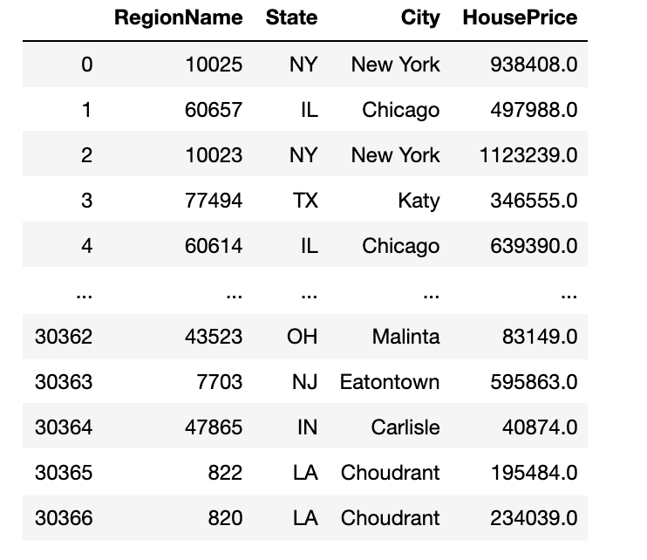
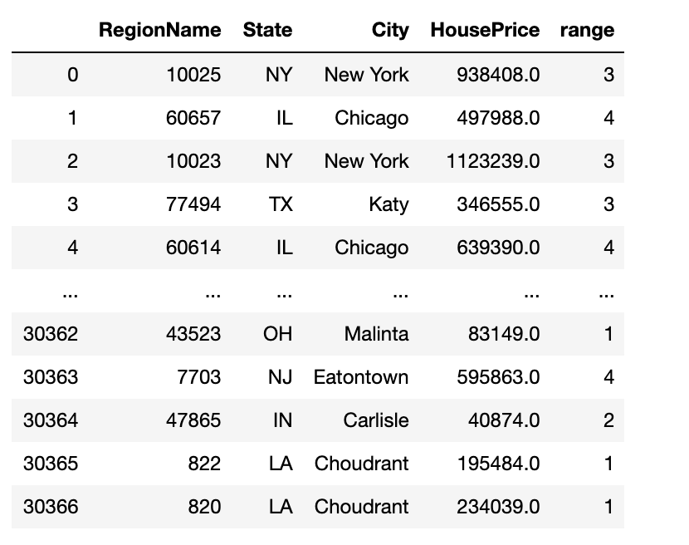
Data Preprocessing - Zillow
Calculated quantiles by states
Assigned housing dollar based on quantiles
0 – 25% quantile: 1, 25% - 50%: 2, 50%-75%: 3, 75% & above: 4
Notes:
In terms of zillow dataset,
We normalized the housing price based on the states.
then, we assigned the dollar sign for housing to make it comparable with our yelp dollar sign. So first we calculated the quantiles for each state and then assign housing dollar based on the quantiles.
0 – 25% quantile: 1 , 25% - 50%: 2, 50%-75%: 75% & above: 4 ( made 4 cutoff points )
And after we assign the dollar sign for housing, you can see the transferred dataset as shown on the slide.

Slide 8
Data Modelling- Features
Attributes : In total we have 102 features (Most are Binaries)
Locations (Non-Binary): Housing range, Postal Code
Yelp review (Non-Binary): Star rating, Review Count
Amenities: Take out, Credit Card, Good For kids , Good for Groups, Delivery, Outdoor Seating, Wi-fi, Table Service, Parking, Dress Code, Noise, Ambiance
Mealtime: Breakfast, Brunch Lunch, Dinner, Latenight
Restaurant Type: Fastfood, Bakeries, Dessert, Food Trucks, Steakhouses, Ice cream & Frozen Yogurt, Bar, Pubs, Nightlife, etc.
Cuisine: American, Mexican, Chinese, French, Italian, Vietnamese, Thai, etc.
Type of Food: Burgers, Sandwiches, Gluten-Free, Vegan, Vegetarian, Pizza, Salad, Tapas , etc.
Notes:
In total we have 102 features (Including the Binary- ex: TakeOut_Yes, Take out_No etc)
We picked all these attributes that could cover the full range of restaurant dollar sign from 1 to 4. because we think these are important attributes that will help the model to make a better accuracy.
Location : location play a big role when it comes to restaurant $. Though we couldn’t find the relationship, but we can’t deny that at least in California, the expensive restaurants are in the expensive area (ex: Newport Beach, Beverly Hills , Laguna Beach)
Yelp review: Indeed, the new restaurants usually don’t have any review when they’re new. We include this in the model because : just like the example we show before, the restaurant do have star and review, but don’t have dollar sign. If there is no review/star we can consider the number as 0. It might lower the accuracy, but the model will still able to make a prediction. Once the restaurant have star/review, it will predict the dollar sign better.
Amenities: This is also another factor that will affect the prediction. Ex: If a restaurant considered as classy – restaurant might fall into a more expensive restaurant. If a restaurant provides valet, the restaurant might be $$$ or $$$$,
Mealtime: the time of meal will affect the price as well. People tend to spend more during dinner. Thus, the mealtime can be an indicator of how much people will spend → which will affect the dollar sign.
Restaurant type: Another factor that will affect price, fast food are most likely to be assigned as ‘$’. While Steakhouses might be $$$ or $$$$
Cuisine: Some cuisine are generally more expensive than the other. Ex: French vs. Chinese
Type of food: Burger vs Tapas. – of course tapas will fall into the more expensive restaurant

Slide 9
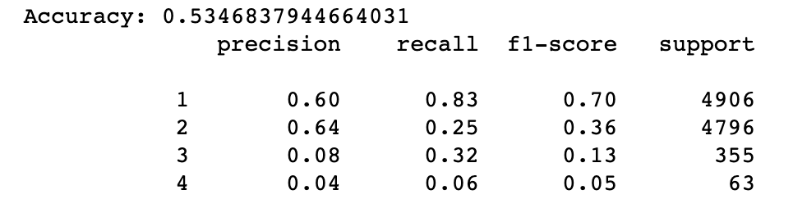
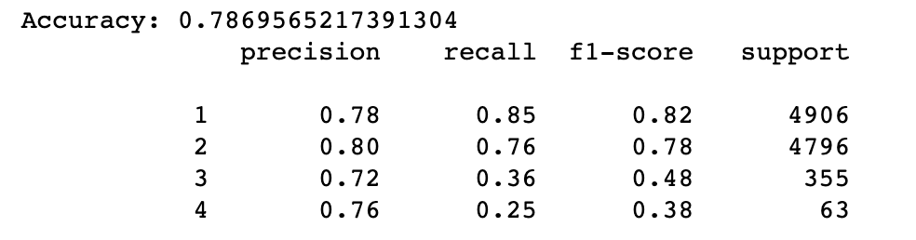
Run the Algorithms
Joined two tables​
Built Model - Naïve Bayes & Random Forest ​
Naïve Bayes
Random Forest
Notes:
After that, we joined the two cleaned data together and created a completed dataset that is ready for building the model.
We used naïve bayes and random forest to make the prediction.
And random forest makes better prediction and the accuracy goes to 78.7%.
It is because naïve bayes usually works well with comparatively small dataset.
And random forest tends to generate better result with bigger dimensional dataset with versatile features.

Slide 10
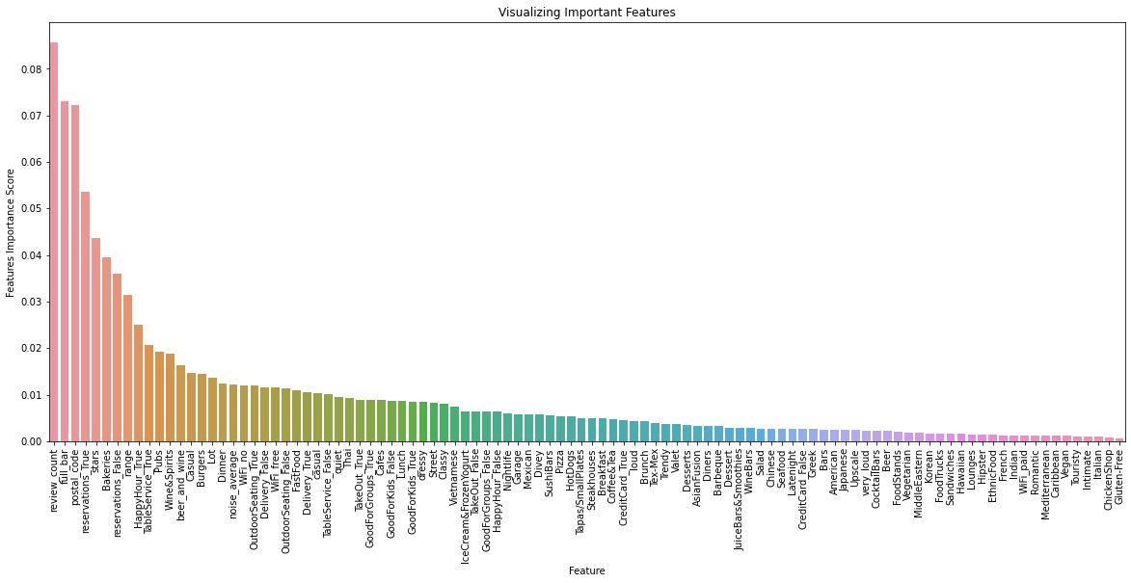
Random Forest - Features Importance
Top 10 Attributes:
Review Count
Full Bar
Postal Code
Reservation
Star
Bakeries
Housing price range
Happy Hour
Table Service
Pubs
Notes:
After running the Random Forest algorithm, we looked for the features importance score. This is the rank of attributes from the most important to the least
Review Count
Full Bar
Postal Code
Reservation
Star
Bakeries
Housing price range
Happy Hour
Table Service
Pubs

Slide 11
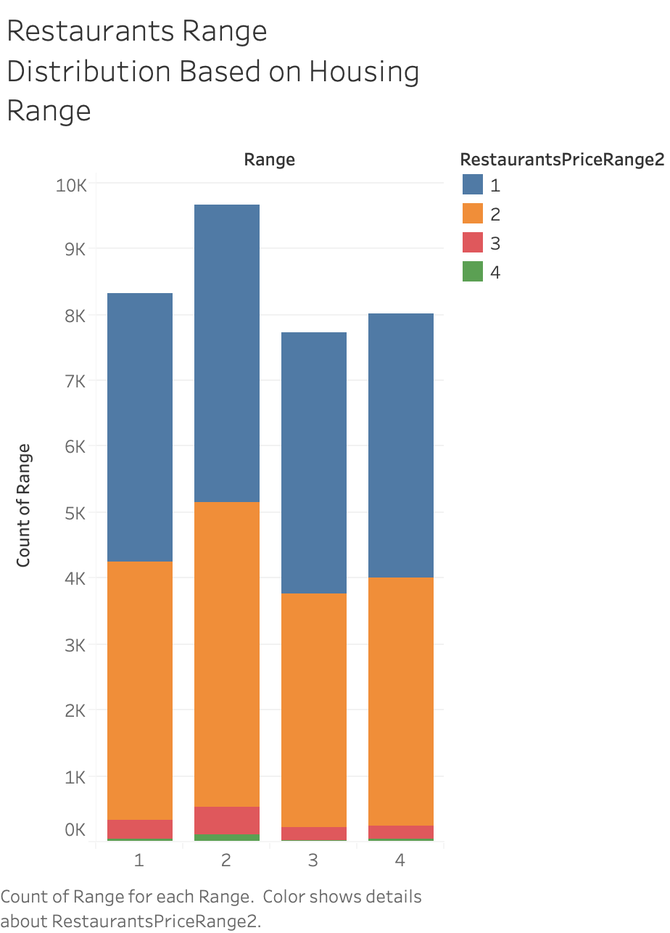
Data Findings - Imbalance Data
Imbalanced Learn was tried but it further decreased the accuracy
Notes:
Graph 1: Showing the distribution of restaurants per dollar sign. As we can see, we have a very imbalance class. Data is heavily distributed on $ and $$.
Graph 2: We try to distribute the restaurant per the housing range. As we can see, $ and $$ dominated all those 4 housing range.
What we found here is the Data is imbalance. we used imbalanced learn as well.
> we try to oversampling the minority, which is 3 and 4 dollar sign restaurant but it gave us a worse accuracy.
-- This is because the class is naturally imbalance ( The $$$/$$$$ are naturally less than $/$$).
We realized that in this data, the number is way too low. In reality the number of $$$/$$$$ are a lot more than what we have here ( but still less than the $,$$) We only have 1089 3 dollar sign and 231 4 dollar sign while 16577 1 dollar sign and 15836 2 dollar sign. Apparently The ratio is naturally imbalanced.

Slide 12
Model Comparison
Naïve Bayes
Random Forest
Notes:
Because of the imbalance data – As we can see, the precision for class 3 and 4 are lower for both model.
Because we don’t have enough 3 and 4 dollar sign data to stretch out the prediction accuracy.

Slide 13
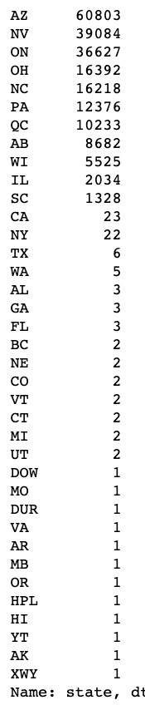
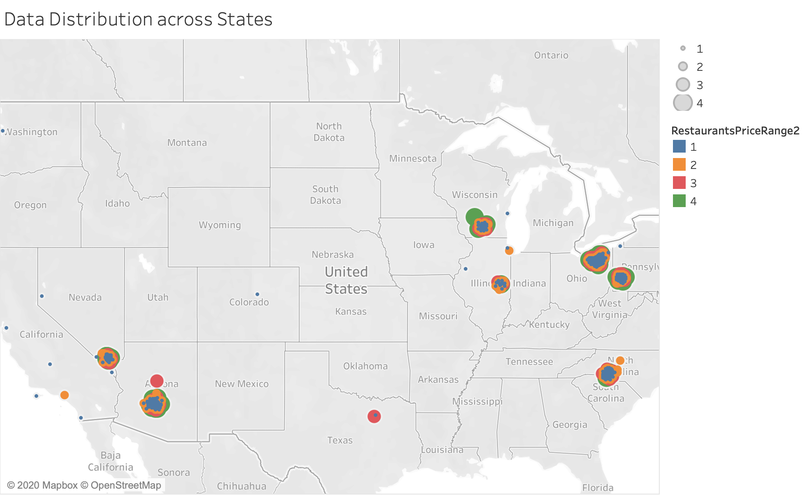
Data Findings - Imbalance Data
Notes:
Since we downloaded the data from Yelp API, we initially thought that yelp will provide the data of all the businesses across United States.
After we geographically mapped out the dataset with data exploration. It turned out
the data only represent couple of states and not all zip code and businesses are in the data. T
This imbalance between state and zip code is a issue for our model since it will not give a good prediction for the states with smaller number of data.

Slide 14
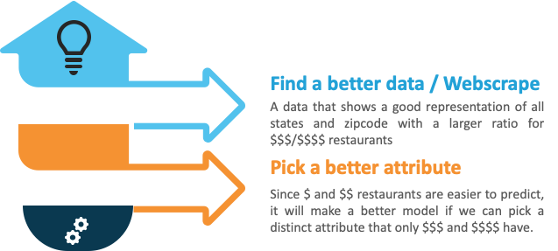
What can be done better?
Notes:
If we are given the chance, we would like to improve the accuracy for the $$$/$$$$ prediction accuracy by 2 approaches
In terms of find a better dataset
1) We would like to solve the problem by having a better distribution of data across all states and data with a better/larger ratio for $$$/$$$$ restaurants
In respect of picking better attributes
2) We would pick a reasonable amount of attributes that will be able to distinct the $/$$ from $$$/$$$$

Slide 15
Business Impact
Yelp
Help Yelp to improve the application by setting a more complete online profile.
New Restaurants
Make new restaurants more filterable (based on dollar sign), visible, and potentially more profitable with more business opportunities.
Notes:
At end of the day, what we have been doing here is to enhance the business performance and efficiency with huge range of aspects.

Slide 16

Questions ?

Slide 17
References and Acknowledgements
https://www.yelp.com/dataset
https://www.zillow.com/research/data/
Thanks to Professor Tingting Nian, Jinan Lin, Scott Mansripattanakul for all your support and guidance throughout this quarter !!

Slide 18
Thank you !

